Slide 1
Python Inheritance Type : Hierarchical PART - 4
In Tamil
By
Monisha S

Slide 2
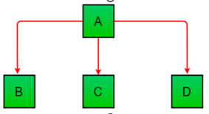
Hierarchical Inheritance
When more than one derived class are created from a single base this type of inheritance is called hierarchical inheritance
Syntax:
Class BaseClass:
{Body}
Class DerivedClass1(BaseClass):
{Body}
Class DerivedClass2(BaseClass):
{Body}

